Slide 1
Maker and Hacker Space
Project documentation

Slide 2
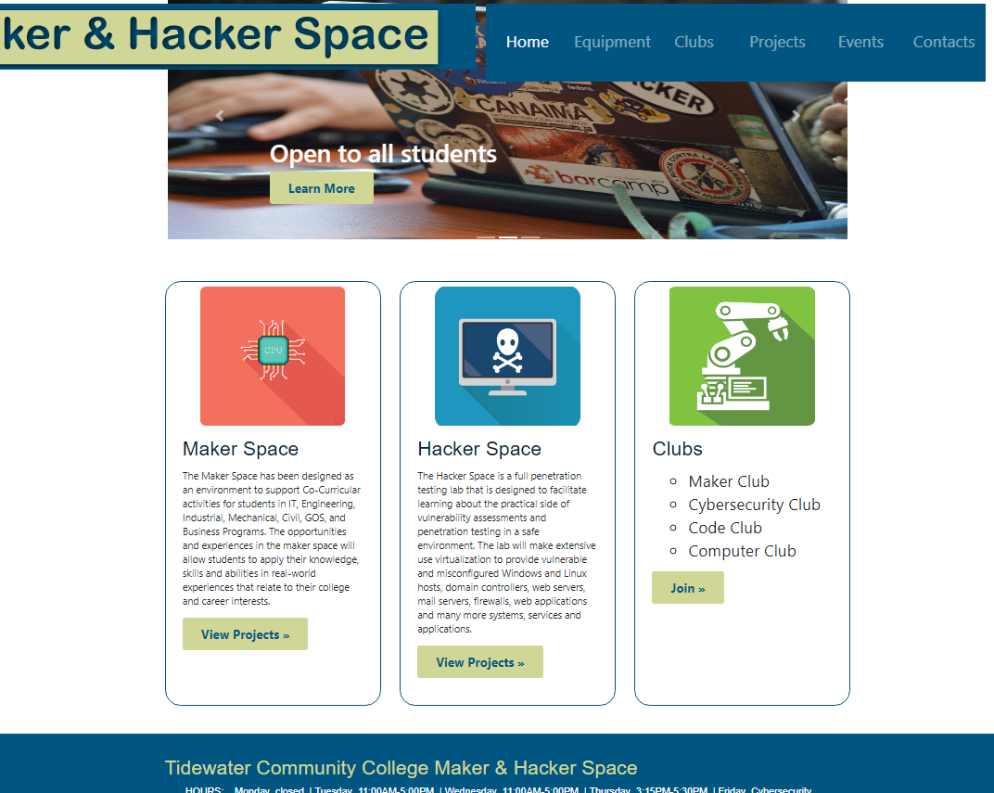
Getting Started
This is the landing page - the page users come to first. You may choose to access any page with this page. The three icons are clickable and take you to the same place as the green buttons do. Maker and Hacker space icons and buttons will take you to the Projects page. The Club icon or button, will take you to the Club page. The buttons on the first slide on the carousel take you to the Club page, the second slide’s button take you to the Contacts page and the third slide button takes you to the Equipment page.
Clickable
Takes you to landing page

Slide 3
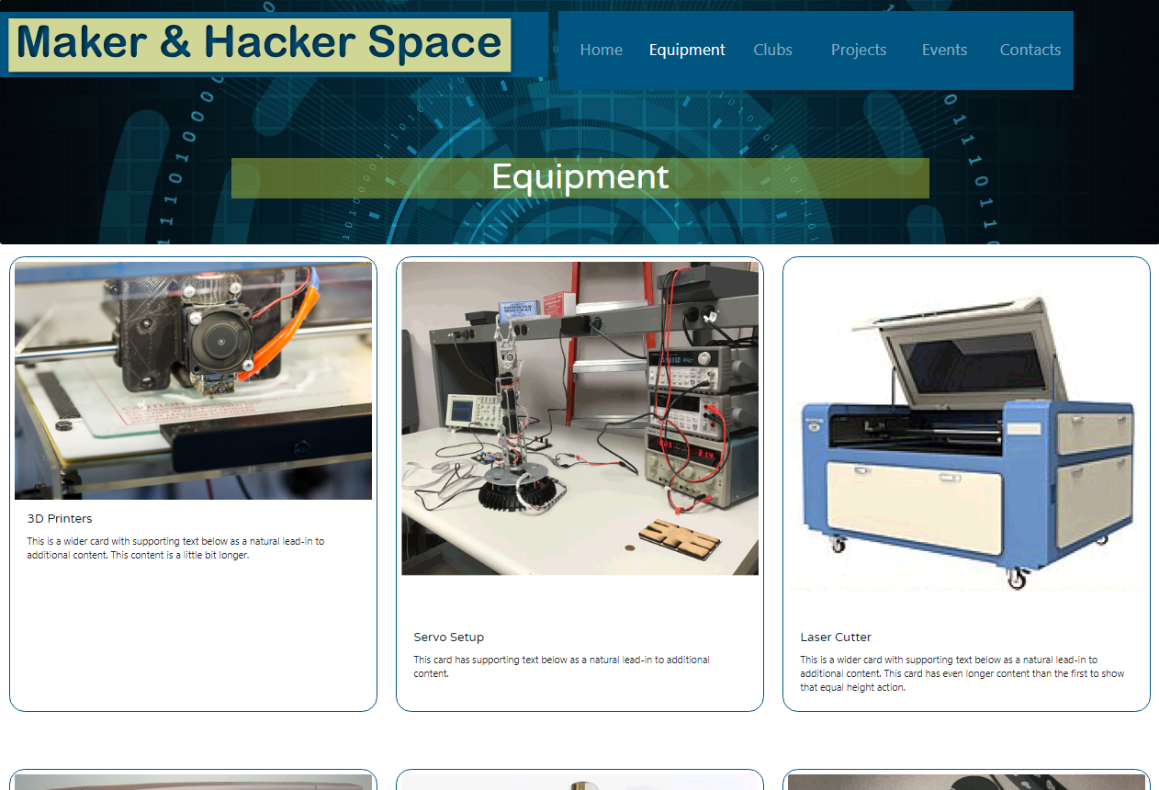
Equipment page
This page lists all of the equipment and descriptions of that equipment used in the Maker and Hacker space

Slide 4
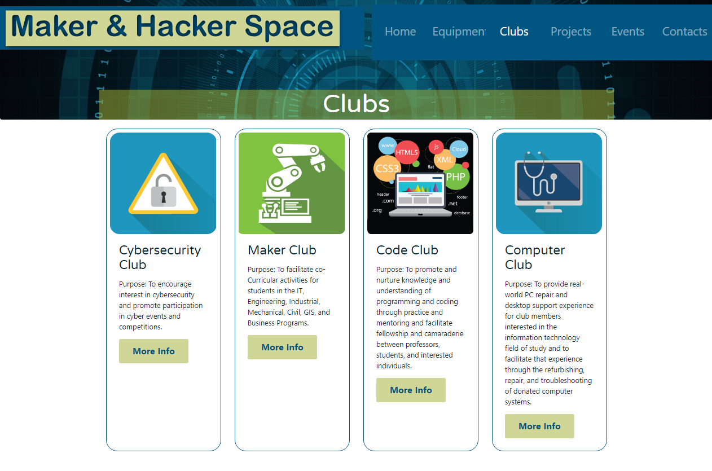
Clubs page
This page shows information for the various clubs the Maker and Hacker Space offers.

Slide 5
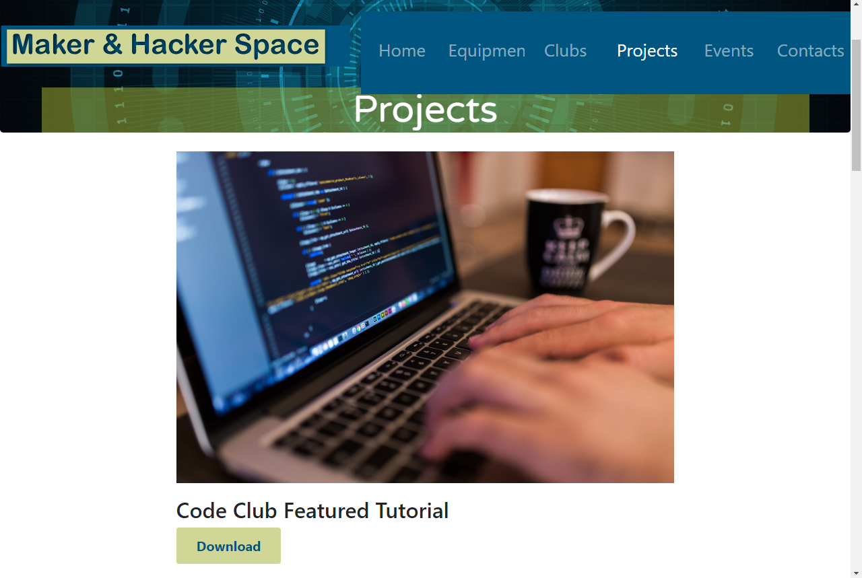
Projects page
This page has a list of tutorials that can be downloaded by the user.
Download link
*Tutorials will download as a pdf

Slide 6
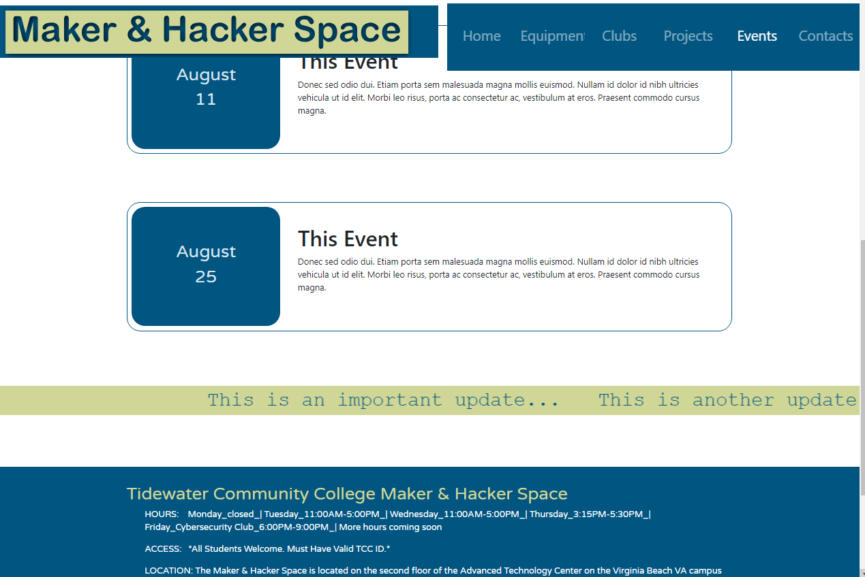
Events page
This page has a calendar for current and upcoming events, also a ticker at the bottom that lists important updates.
Ticker
Shows important updates
Footer
-Present on every page
List address, phone numbers, hours of Maker and Hacker Space, and social media links

Slide 7
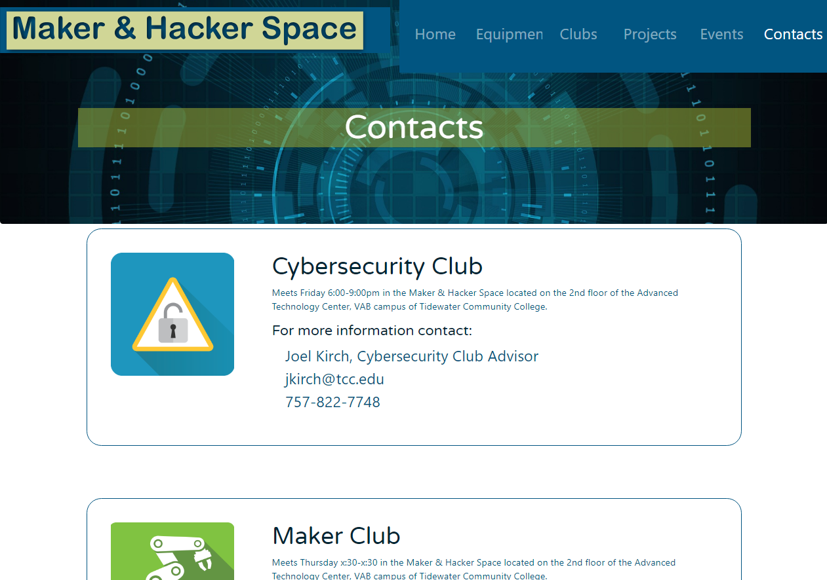
Contacts page
This page lists meeting times for all clubs and also important phone numbers and emails.

Slide 8
Recommended hosting strategy for Website: BlueHost, Inc
Recommendation based on the following factors:
Bluehost is among the most cost competitive commercial third party solutions. (<$50 annually for basic subscription)
TCC’s Maker & Hacker Space informational website has low disk space (<21MB) and bandwidth requirements (<1 GB/month), and does not require domain name registration.
Bluehost’s basic subscription includes access to advanced features, allowing for more expansive development of the site after the lab becomes more established.
Bluehost, Inc | Basic Subscription
Per month for one website | $3.95
Disk Space | 50 GB SSD
Bandwidth | Unmetered
cPanel, SSL, choice of database, e-commerce, cms, and server-side script apps | Included
Email | 5 Accounts
SSDs | Can be added as needed
Order from website: http://www.bluehost.com

Slide 9
BELOW IS THE MEDIA USED FOR THE SITE WITH TERMS OF SERVICE ATTACHED
Pixabay.com
Media used-Images
Code.jpg
cyber.jpg
cyberSec.png
hacker.jpg
team.jpg
tech2.jpg

Slide 10
BELOW IS THE MEDIA I USED FOR THE SITE WITH TERMS OF SERVICE ATTACHED
Depositphotos.com
Media used-Images
cpuIcon.png
codeIcon.png
hackIcon.png
healthIcon.png
roboIcon.png
TCC Maker and Hacker Space
Media used-Images
3SPrint.jpg
IMG_0137.jpg
lasercutter.png
plotter.png
raspberrypiboard.jpg
raspberrypiboardA.jpg
servosetup.png
sideboard.png
sideboardA.jpg

Slide 11
Installation and setup of Maker and Hacker Space site
Installation of site is quick and simple!
Put CD in computer
Move Maker and Hacker Space Website folder to a directory on your computer or one designated by your hosting provider. Make sure the location is secure and where no one can access the directory to make alterations without permission.
Inside the folder there is another folder named “images.” This is where all of the images for the site are kept. Make sure that folder stays in the main folder. Please do not move this folder or your images will not show on the site.
The html files are named by website page just in case you need to make any changes to the code. You can do this by using whatever text editor program of your choosing.
The css files are files that hold the design and structure of the site. These files do not need to be touched unless you want to make changes, which in that case, you will use a text editor program of your choosing.
The js files are files used to execute JavaScript functions such as implementing basic automations and interactive features. Do not touch this file unless changes need to be made. Please use a professional when making these changes.
Enjoy your site!

